Slide 1
CSE4255 Cellular Network
Lecture 7:
Trunking and Grade of Service

Slide 2
Why Trunking?
Main Problems in Subscriber Service:
Limited number of channels
Many Users
Purpose of trunking theory is
To determine the required capacity and allocate the proper number of channel in order to meet GOS.
GOS:
Grade of service is the measure of user’s ability to access a trunked system during busiest hour.
Notes:
So the solution is trunking. This is also called trunking theory.
In cellular mobile communication, the two major aspects that have to be considered with extra care are: trunking, and grade of service. These aspects are to be planned very well in order to get a better system performance.

Slide 3
Trunking
Trunking theory was represented by Erlang in late 19th century.
Trunking is the concept that allows a large no of users to share a relatively small number of channels in a cell.
In a trunked radio system (TRS) –
Each user is allocated a channel on a per call basis from a pool of available channels.
Upon termination of the call, the previously occupied channel is immediately returned to the pool of available channels.

Slide 4
Common terms in Trunking
Setup Time: Time required to allocate a radio channel to a requesting user.
Blocked Call: Call which cannot be completed at the time of request, due to congestion(lost call)
Holding Time: Average duration of a typical call. Denoted by H(in seconds)
Request Rate: The average number of calls requests per unit time( λ)
Traffic Intensity: Measure of channel time utilization or the average channel occupancy measured in Erlangs. Dimensionless quantity. Denoted by A
Load: Traffic intensity across the entire TRS (Erlangs)

Slide 5
Erlang--a Unit of Traffic
An Erlang is a unit of telecommunications traffic measurement:
Represents the continuous use of one voice path.
Describe the total traffic volume of one hour
A channel kept busy for one hour is defined as having a load of one Erlang
For example, a radio channel that is occupied for thirty minutes during an hour carries 0.5 Erlangs of traffic
For 1 channel
Min load=0 Erlang (0% time utilization)
Max load=1 Erlang (100% time utilization)
Notes:
The fundamentals of trunking theory was developed by Erlang, a Danish mathematician, the unit bears his name.

Slide 6
Traffic Intensity
Traffic intensity generated by each user : A_{u} Erlangs
A_{u} = λH
H : average duration of the call
: average number of call requests per unit time
For a system containing U users and unspecified number of channels,
Total offered traffic intensity : A Erlangs
A = U A_{u}
In C channel trunked system, if the traffic is equally distributed among the channels,
Traffic intensity per channel : A_{c} Erlangs
A_{c} = U A_{u}/ C

Slide 7
Erlang--Example
If a group of 100 users made 30 calls in one hour, and each call had an average call duration (holding time) of 5 minutes, then the number of Erlangs is worked out as follows:
Minutes of traffic in the hour = number of calls x duration
Minutes of traffic in the hour = 30 x 5 = 150
Hours of traffic in the hour = 150 / 60 = 2.5
Traffic Intensity= 2.5 Erlangs

Slide 8
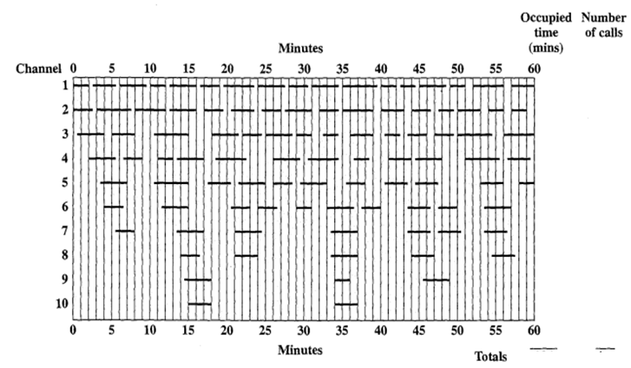
Traffic Intensity: Example

Slide 9
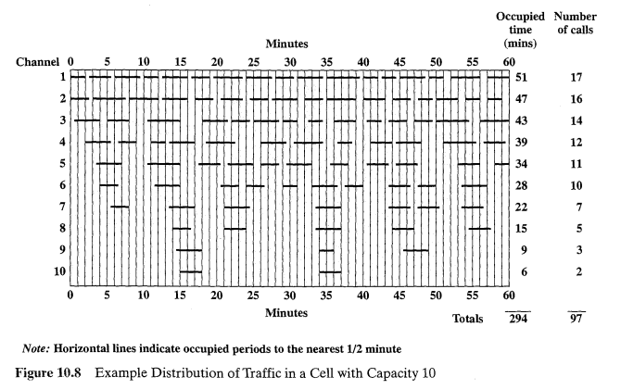
Traffic Intensity: Example

Slide 10
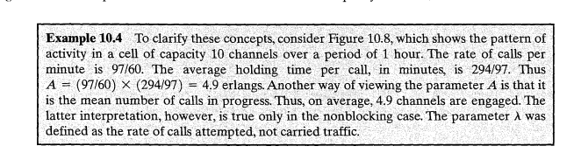
Traffic Intensity: Example

Slide 11
Grade of Service
The grade of service (GOS) is related to the ability of a mobile phone to access the trunked mobile phone system during the busiest hour.
To meet a specific GOS, the maximum required capacity of the system must be estimated and the proper number of channels must be allocated for the system
GOS is a measure of the congestion of the system which is specified as
The probability of a call being blocked: Blocked calls cleared (BCC) or Lost Call Cleared (LCC) or Erlang B systems or
The probability of a call being delayed beyond a certain amount of time before being granted access: Blocked call delayed or Lost Call Delayed (LCD) or Erlang C systems

Slide 12
Blocked Call Cleared Systems
When a user requests service, there is a minimal call set-up time and the user is given immediate access to a channel if one is available
If channels are already in use and no new channels are available, call is blocked without access to the system
The user does not receive service, but is free to try again later
All blocked calls are instantly returned to the user pool

Slide 13
Modeling of BCC Systems
The Erlang B model is based on following assumptions :
Calls are assumed to arrive with a Poisson distribution
There are nearly an infinite number of users
Call requests are memory less, implying that all users, including blocked users, may request a channel at any time
All free channels are fully available for servicing calls until all channels are occupied
The probability of a user occupying a channel (called service time) is exponentially distributed. Longer calls are less likely to happen.
There are a finite number of channels available in the trunking pool.
Inter-arrival times of call requests are independent of each other

Slide 14
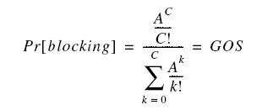
Modeling of BCC Systems
Erlang B formula: determines the probability that the call is blocked, and is the measure of the GOS for a trunked system that provides no queuing for blocked calls.
Where: C = number of trunked channels offered by a trunked radio system A = Total offered traffic.

Slide 15
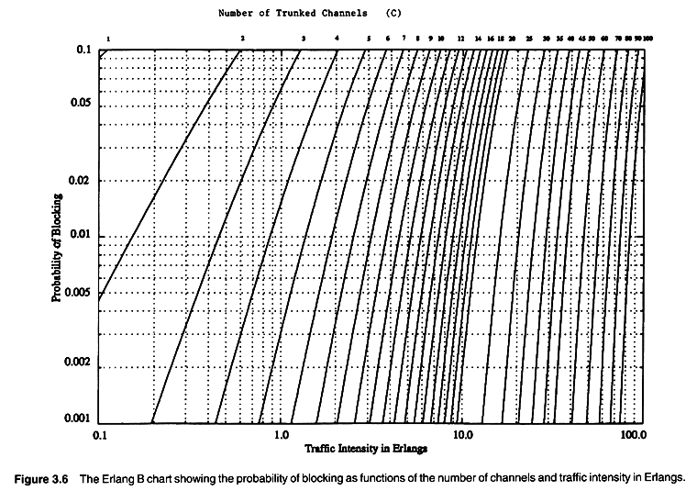
Erlang B
Notes:
Table: shows the amount of traffic (in Erlangs) carried by a given number of channels n for different blocking probability values.

Slide 16
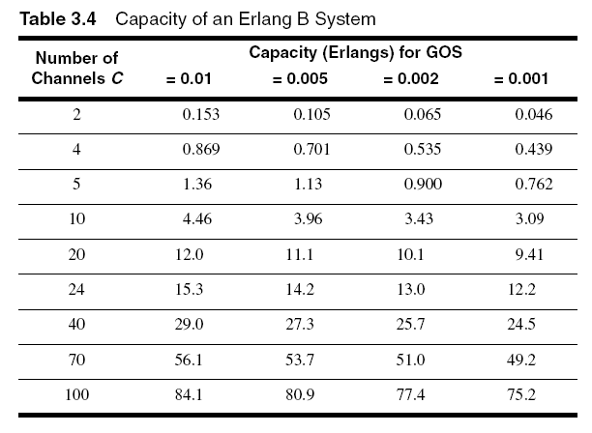
Erlang B Trunking GOS

Slide 17
BCC System Example-1
How many users can be supported for 0.5% blocking probability for the following number of trunked channels in a BCC system? (a) 5, (b) 10,(c)=20. Assumed that each user generates 0.1 Erlangs of traffic.
Solution:
Given C=5, GOS=0.005, Au=0.1,
From graph/Table using C=5 and GOS=0.005,A=1.13
Total Number of users U=A/Au=1.13/0.1=11 users

Slide 18
BCC System Example-2
Assuming that each user in a system generates a traffic intensity of 0.2 Erlangs, how many users can be supported for 0.1% probability of blocking in an Erlang B system for a number of trunked channels equal to 60.
Solution :
System is an Erlang B
A_{u} = 0.2 Erlangs
Pr [Blocking] = 0.001
C = 60 Channels
From the Erlang B figure, we see that
A ≈ 40 Erlangs
Therefore U=A/Au=40/0.02=2000users.

Slide 19
Blocked Call Delayed(BCD) Systems
Queues are used to hold call requests that are initially blocked
When a user attempts a call and a channel is not immediately available, the call request may be delayed until a channel becomes available
Mathematical modeling of such systems is done by Erlang C formula
The Erlang C model is based on following assumptions :
Similar to those of Erlang B
Additionally, if offered call cannot be assigned a channel, it is placed in a queue which has a finite length
Each call is then serviced in the order of its arrival

Slide 20

Blocked Call Delayed Systems (BCD)
Erlang C formula which gives likelihood of a call not having immediate access to a channel (all channels are already in use)

Slide 21
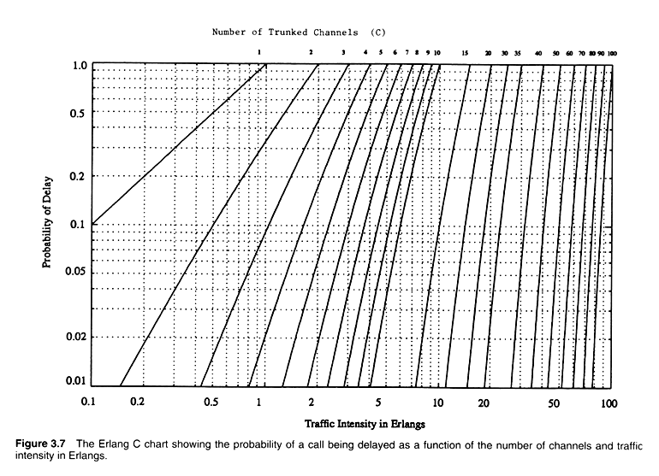
Erlang C
=

Slide 22
Modeling of BCD Systems
Probability that any caller is delayed in queue for a wait time greater than t seconds is given as GOS of a BCD System
The probability that the delayed call is forced to wait more than t seconds is given by the probability that a call is delayed, multiplied by the conditional probability that the delay is greater than t seconds.
The GOS of a trunked system where blocked calls are delayed is hence given by
Pr[delay>t] = Pr [delay>0] Pr [delay>t| delay>0]
Where P[delay>t| delay>0]= e^{(-(C-A)t/H)}
Pr[delay>t] = Pr [delay>0] e(-(C-A)t/H)
where C = total number of channels, t =delay time of interest, H=average duration of call

Slide 23
Trunking Efficiency
Trunking efficiency is a measure of the number of users which can be offered a particular GOS with a particular configuration of fixed channels.
The way in which channels are grouped can substantially alter the number of users handled by a trunked system.
Example:
10 trunked channels at a GOS of 0.01 can support 4.46 Erlangs, where as two groups of 5 trunked channels can support 2x1.36=2.72 Erlangs of traffic
10 trunked channels can offer 60% more traffic at a specific GOS than two 5 channel trunks.
Therefore, if in a certain situation we sub-divide the total channels in a cell into smaller channel groups then the total carried traffic will reduce with increasing number of groups

Slide 24
Problem 1
An urban area has a population of two million residents. Three competing trunked mobile networks (systems A, B, and C) provide cellular service in this area. System A has 394 cells with 19 channels each, system B has 98 cells with 57 channels each, and system C has 49 cells, each with 100 channels. Find the number of users that can be supported at 2% blocking if each user averages two calls per hour at an average call duration of three minutes. Assuming that all three trunked systems are operated at maximum capacity, compute the percentage market penetration of each cellular provider..

Slide 25
Problem 2
A certain city has an area of 1,300 square miles and is covered by a cellular
system using a seven-cell reuse pattern. Each cell has a radius of four miles
and the city is allocated 40 MHz of spectrum with a full duplex channel bandwidth of 60 kHz. Assume a GOS of 2% for an Erlang B system is specified. If the offered traffic per user is 0.03 Erlangs, compute (a) the number of cells in the service area, (b) the number of channels per cell, (c) traffic intensity of each cell, (d) the maximum carried traffic, (e) the total number of users that can be served for 2% GOS, (f) the number of mobiles per unique channel (where it is understood that channels are reused), and (g) the theoretical maximum number of users that could be served at one time by the system.

Slide 26
Problem 3
A hexagonal cell within a four-cell system has a radius of 1.387 km. A total
of 60 channels are used within the entire system. If the load per user is
0.029 Erlangs, and λ = 1 call/hour, compute the following for an Erlang C
system that has a 5% probability of a delayed call:
(a) How many users per square kilometer will this system support?
(b) What is the probability that a delayed call will have to wait for
more than 10 s?
(c) What is the probability that a call will be delayed for more than 10
seconds?

Slide 27
Problem 4
Consider a 7-cell system covering an area of 3100 km2. The traffic in the seven cells is as follows:
Cell number 1 2 3 4 5 6 7 Traffic (Erlangs) 30.8 66.7 48.6 33.2 38.2 37.8 32.6
Each user generates an average of 0.03 Erlangs of traffic per hour, with a mean holding time of 120 s. The system consists of a total of 395 channels and is designed for a grade of service of 0.01. a. Determine the number of subscribers in each cell. b. Determine the number of calls per hour per subscriber. c. Determine the number of calls per hour in each cell. d. Determine the number of channels required in each cell. Hint: You will need to extrapolate using Table 10.3. e. Determine the total number of subscribers. f. Determine the average number of subscribers per channel. g. Determine the subscriber density per km2• h. Determine the total traffic (total Erlangs). i. Determine the Erlangs per km2. j. What is the radius of a cell?

